Slide 1
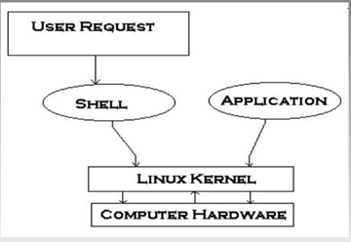
Shell Scripting
A shell is a program that acts as the interface between you and the Linux system.
Shell scripts automates various administrative tasks.
Kinds of shells:
Bourne shell
C shell
Korn shell
Bash shell
cat /etc/shells
/bin/sh
/bin/dash Debian Almquist Shell
/bin/bash Bourne-Again SHell
/bin/rbash alternative to chrooted accounts
Compiled By – Jyoti Malhotra;
Reference: CSCI 330 - The Unix System

Slide 2
BASIC SHELL PROGRAMMING
A script is a file that contains shell commands
data structure: variables
control structure: sequence, decision, loop
Shebang line for bash shell script:
#! /bin/bash - meaning that the script should always be run with bash
#! /bin/sh
to run:
bash script.sh
make executable: chmod +x script.sh
invoke via: ./script.sh
‹#›

Slide 3
BASH SHELL PROGRAMMING
Input
prompting user
command line arguments
Decision:
if-then-else OR test
case
Repetition
do-while, repeat-until
for
select
Functions
Traps
Comments - #
‹#›

Slide 4
USER INPUT
shell allows to prompt for user input
Syntax:
read varname
read a b c
Or read –p "prompt" varname [more vars]
words entered by user are assigned to varname and “more vars”
last variable gets rest of input line
Example:
#! /bin/sh
read -p "enter your name: " first last
echo "First name: $first"
echo "Last name: $last"
‹#›

Slide 5
SPECIAL SHELL VARIABLES
Parameter | Meaning
$0 | Name of the current shell script
$1-$9 | Positional parameters 1 through 9
$# | The number of positional parameters
$? | Return status of most recently executed command
$$ | Process id of current process
‹#›

Slide 6
BASH CONTROL STRUCTURES
if-then-else
case
loops
for
while
until
select
IF STATEMENT
if command
then
statements
fi
statements are executed only if command succeeds, i.e. has return status “0”
‹#›

Slide 7
THE SIMPLE IF STATEMENT
if [ condition ]; then
statements
fi
executes the statements only if condition is true
THE IF-THEN-ELSE STATEMENT
if [ condition ]; then
statements-1
else
statements-2
fi
executes statements-1 if condition is true
executes statements-2 if condition is false
‹#›

Slide 8
THE IF…STATEMENT
if [ condition ]; then
statements
elif [ condition ]; then
statement
else
statements
fi
The word elif stands for “else if”
‹#›

Slide 9
RELATIONAL OPERATORS
Meaning | Numeric | String
Greater than | -gt
Greater than or equal | -ge
Less than | -lt
Less than or equal | -le
Equal | -eg | = or ==
Not equal | -ne | !=
str1 is less than str2 |  | str1 < str2
str1 is greater str2 |  | str1 > str2
String length is greater than zero |  | -n str
String length is zero |  | -z str
‹#›

Slide 10
COMPOUND LOGICAL EXPRESSIONS
! not
&& and
|| or
and, or
must be enclosed within
[[ ]]
‹#›

Slide 11
EXAMPLE: USING THE ! OPERATOR
#!/bin/bash
read -p "Enter years of work: " Years
if [ ! $Years -lt 20 ]; then
echo "You can retire now."
else
echo "You need 20+ years to retire"
fi
‹#›

Slide 12
EXAMPLE: USING THE && OPERATOR
#!/bin/bash
Bonus=500
read -p "Enter Status: " Status
read -p "Enter Shift: " Shift
if [[ "$Status" = "H" && "$Shift" = 3 ]]
then
echo "shift $Shift gets \$$Bonus bonus"
else
echo "only hourly workers in"
echo "shift 3 get a bonus"
fi
‹#›

Slide 13
FILE TESTING
Meaning
-d file True if ‘file’ is a directory
-f file True if ‘file’ is an ord. file
-r file True if ‘file’ is readable
-w file True if ‘file’ is writable
-x file True if ‘file’ is executable
-s file True if length of ‘file’ is nonzero
‹#›

Slide 14
EXAMPLE: FILE TESTING
#!/bin/bash
echo "Enter a filename: "
read filename
if [ ! –r "$filename" ]
then
echo "File is not read-able"
exit 1
fi
‹#›

Slide 15
EXAMPLE: IF… STATEMENT
# The following THREE if-conditions produce the same result
* DOUBLE SQUARE BRACKETS
read -p "Do you want to continue?" reply
if [[ $reply = "y" ]]; then
echo "You entered " $reply
fi
* SINGLE SQUARE BRACKETS
read -p "Do you want to continue?" reply
if [ $reply = "y" ]; then
echo "You entered " $reply
fi
* "TEST" COMMAND
read -p "Do you want to continue?" reply
if test $reply = "y"; then
echo "You entered " $reply
fi
‹#›

Slide 16
THE CASE STATEMENT
use the case statement for a decision that is based on multiple choices
Syntax:
case word in
pattern1) command-list1
;;
pattern2) command-list2
;;
patternN) command-listN
;;
esac
‹#›

Slide 17
CASE PATTERN
checked against word for match
may also contain:
*
?
[ … ]
[:class:]
multiple patterns can be listed via: |
‹#›

Slide 19
EXAMPLE 1: THE CASE STATEMENT
#!/bin/bash
echo "Enter Y to see all files including hidden files"
echo "Enter N to see all non-hidden files"
echo "Enter q to quit"
read -p "Enter your choice(Y/N): " reply
case $reply in
Y|YES) echo "Displaying all (really…) files"
ls -a ;;
N|NO) echo "Display all non-hidden files..."
ls ;;
Q) exit 0 ;;
*) echo "Invalid choice!"; exit 1 ;;
esac
‹#›

Slide 20
EXAMPLE 2: THE CASE STATEMENT
#!/bin/bash
ChildRate=3
AdultRate=10
SeniorRate=7
read -p "Enter your age: " age
case $age in
[1-9]|[1][0-2]) # child, if age 12 and younger
echo "your rate is $ChildRate.00" ;;
[1][3-9]|[2-5][0-9]) # adult, if age is between 13 & 59
echo "your rate is $AdultRate.00" ;;
[6-9][0-9]) # senior, if age is 60+
echo "your rate is "$SeniorRate.00" ;;
esac
‹#›

Slide 21
expr
Shell programming is not good at numerical computation, it is good at text processing.
However, the expr command allows simple integer calculations.
Here is an interactive Bourne shell example:
$ i=1
$ expr $i + 1
2
To assign the result of an expr command to another shell variable, surround it with backquotes:
$ i=1
$ i=`expr $i + 1`
$ echo "$i"
2

Slide 22
expr
The * character normally means “all the files in the current directory”, so you need a “\” to use it for multiplication:
$ i=2
$ i=`expr $i \* 3`
$ echo $i
6
expr also allows you to group expressions, but the “(“ and “)” characters also need to be preceded by backslashes:
$ i=2
$ echo `expr 5 + \( $i \* 3 \)`
11

Slide 23
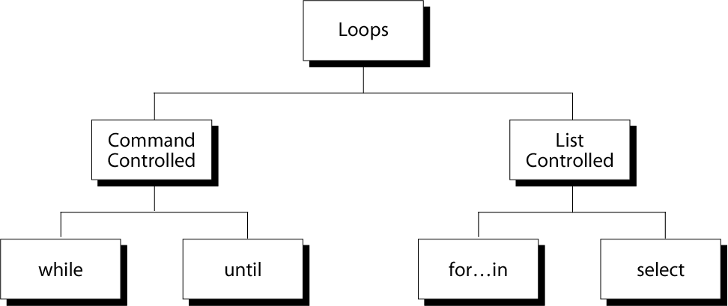
REPETITION CONSTRUCTS
‹#›

Slide 24
THE WHILE LOOP
Purpose: To execute commands in “command-list” as long as “expression” evaluates to true
Syntax:
while [ expression ]
do
command-list
done
EXAMPLE: USING THE WHILE LOOP
#!/bin/bash
COUNTER=0
while [ $COUNTER -lt 10 ]
do
echo The counter is $COUNTER
let COUNTER=$COUNTER+1
done
‹#›

Slide 25
EXAMPLE: USING THE WHILE LOOP
#!/bin/bash
Cont="Y"
while [ $Cont = "Y" ]; do
ps -a
read -p "want to continue? (Y/N)" reply
Cont=`echo $reply | tr [:lower:] [:upper:]`
Done
echo "done"
Tr: Convert incoming text
‹#›

Slide 26
THE UNTIL LOOP
Purpose: To execute commands in “command-list” as long as “expression” evaluates to false
Syntax:
until [ expression ]
do
command-list
done
#!/bin/bash
COUNTER=20
until [ $COUNTER -lt 10 ]
do
echo $COUNTER
let COUNTER-=1
done
‹#›

Slide 27
THE FOR LOOP
Purpose: To execute commands as many times as the number of words in the “argument-list”
Syntax:
for variable in argument-list
do
commands
done
#!/bin/bash
for i in 7 9 2 3 4 5
do
echo $i
done
‹#›

Slide 28
EXAMPLE 2: USING THE FOR LOOP
#!/bin/bash
# compute the average weekly temperature
for num in 1 2 3 4 5 6 7
do
read -p "Enter temp for day $num: " Temp
let TempTotal=$TempTotal+$Temp
done
let AvgTemp=$TempTotal/7
echo "Average temperature: " $AvgTemp
‹#›
let is a builtin command of the Bash shell that evaluates arithmetic expressions

Slide 29
BREAK AND CONTINUE
Interrupt for, while or until loop
The break statement
transfer control to the statement AFTER the done statement
terminate execution of the loop
The continue statement
transfer control to the statement TO the done statement
skip the test statements for the current iteration
continues execution of the loop
while [ condition ]
do
cmd-1
continue
cmd-n
done
echo "done"
This iteration is over; do the next iteration
‹#›
Notes:
‹#›

Slide 30
SHELL FUNCTIONS
A shell function is similar to a shell script
stores a series of commands for execution later
shell stores functions in memory
shell executes a shell function in the same shell that called it
Where to define
In your script OR on the command line
Remove a function
Use unset built-in
‹#›
Notes:
‹#›

Slide 31
SHELL FUNCTIONS
must be defined before they can be referenced
usually placed at the beginning of the script
Syntax:
function-name () {
statements
}
‹#›

Slide 32
EXAMPLE: FUNCTION
#!/bin/bash
sample () {
# This is a simple function
no=` expr $no – 1` #Evaluate expression
echo "This is a sample function."
echo "Now exiting the function."
}
# declaration must precede call:
sample
‹#›

Slide 33
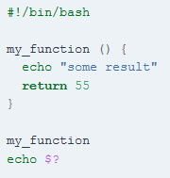


Slide 34
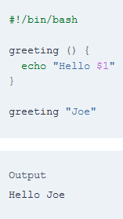
FUNCTION PARAMETERS
Need not be declared
Arguments provided via function call are accessible inside function as $1, $2, $3, …
$# reflects number of parameters
$0 Function name
‹#›

Slide 35
EXAMPLE: FUNCTION WITH PARAMETER
#! /bin/sh
testfile() {
if [ $# -gt 0 ]; then
if [[ -f $1 && -r $1 ]]; then
echo $1 is a readable file
else
echo $1 is not a readable file
fi
fi
}
testfile .
testfile funtest
‹#›

Slide 36
HANDLING SIGNALS
Unix allows you to send a signal to any process
1 = hangup kill -HUP 1234
2 = interrupt with ^C kill -2 1235
no argument = terminate kill 1235
9 = kill kill -9 1236
-9 cannot be blocked
list your processes with
ps -u userid
‹#›

Slide 37
SIGNALS ON LINUX
% kill –l
1) SIGHUP 2) SIGINT 3) SIGQUIT 4) SIGILL
5) SIGTRAP 6) SIGABRT 7) SIGBUS 8) SIGFPE
9) SIGKILL 10) SIGUSR1 11) SIGSEGV 12) SIGUSR2
13) SIGPIPE 14) SIGALRM 15) SIGTERM 16) SIGSTKFLT
17) SIGCHLD 18) SIGCONT 19) SIGSTOP 20) SIGTSTP
21) SIGTTIN 22) SIGTTOU 23) SIGURG 24) SIGXCPU
25) SIGXFSZ 26) SIGVTALRM 27) SIGPROF 28) SIGWINCH
29) SIGIO 30) SIGPWR 31) SIGSYS 34) SIGRTMIN
35) SIGRTMIN+1 36) SIGRTMIN+2 37) SIGRTMIN+3 38) SIGRTMIN+4
39) SIGRTMIN+5 40) SIGRTMIN+6 41) SIGRTMIN+7 42) SIGRTMIN+8
43) SIGRTMIN+9 44) SIGRTMIN+10 45) SIGRTMIN+11 46) SIGRTMIN+12
47) SIGRTMIN+13 48) SIGRTMIN+14 49) SIGRTMIN+15 50) SIGRTMAX-14
51) SIGRTMAX-13 52) SIGRTMAX-12 53) SIGRTMAX-11 54) SIGRTMAX-10
55) SIGRTMAX-9 56) SIGRTMAX-8 57) SIGRTMAX-7 58) SIGRTMAX-6
59) SIGRTMAX-5 60) SIGRTMAX-4 61) SIGRTMAX-3 62) SIGRTMAX-2
63) SIGRTMAX-1 64) SIGRTMAX
^C is 2 - SIGINT
‹#›

Slide 38
EXAMPLE: REMOVING TEMP FILES
#! /bin/bash
trap 'cleanup; exit' 2
cleanup () {
/bin/rm -f /tmp/tempfile.$$.?
}
for i in 1 2 3 4 5 6 7 8
do
echo "$i.iteration"
touch /tmp/tempfile.$$.$i
sleep 1
done
cleanup
CSCI 330 - The Unix System
‹#›

